Slide 1

System Performance Analyzer
Measuring, Monitoring, and Optimizing System Performance
Team Name : Architechs
Subjects: Software Engineering (Operating System)
Team ID: SE(OS)-VI-T250

Slide 2

Introduction to System Performance Analysis
Definition
Purpose
Systematic evaluation of system resources, capabilities, and efficiency to understand performance characteristics.
Identify bottlenecks and limitations
Establish performance baselines
Verify system meets SLAs
Guide optimization and capacity planning
Applicable Systems
Computer hardware
Operating systems
Networks, applications, services
Databases

Slide 3

Key Performance Metrics
Category
Metrics
Description
CPU
Utilization, Load average, Context switches
Measures processor capacity and workload efficiency
Memory
Usage, Page faults, Swap usage
Evaluates memory availability and management
Disk I/O
IOPS, Throughput, Latency
Analyzes storage system performance under load
Network
Bandwidth, Packet loss, Latency
Measures network efficiency and reliability
Application
Response time, Throughput, Error rate
Evaluates application performance and stability

Slide 4
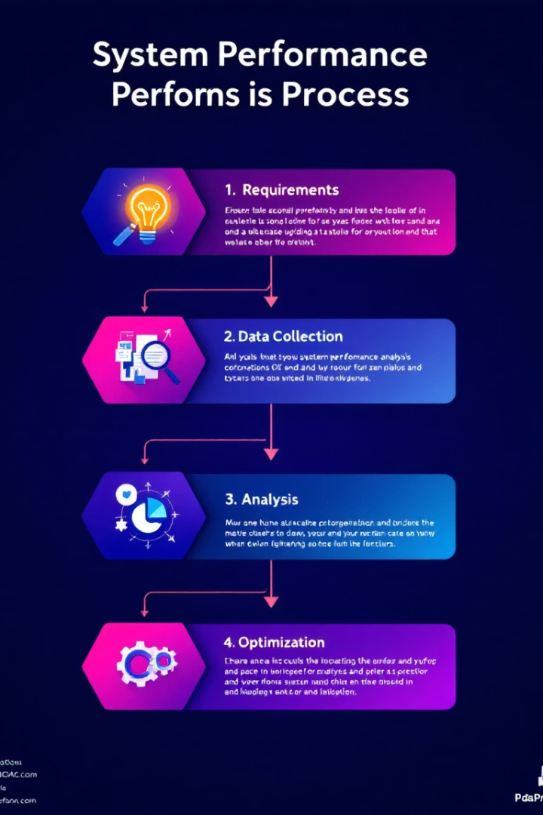




Performance Analysis Methodology
Requirements Definition
Set performance goals and SLAs
Identify critical metrics and thresholds
Instrumentation & Data Collection
Deploy monitoring tools to capture data
Establish performance baselines
Analysis & Diagnosis
Identify patterns, anomalies, and bottlenecks
Correlate events across system components
Optimization & Tuning
Implement improvements and configuration changes
Validate performance gains with testing

Slide 5
Performance Analysis Tools
System-level Tools
Application Performance Monitoring (APM)
Specialized Tools
Linux: top, vmstat, iostat, sar
Network analysis: Wireshark, iperf
Windows: Performance Monitor, Resource Monitor
New Relic, Datadog, AppDynamics
Database: explain plans, query analyzers
Distributed tracing frameworks for microservices
Cross-platform: htop, glances, Nagios
Profilers: CPU, memory, code execution profiling

Slide 6
Performance Testing Techniques
1
Load Testing
2
Stress Testing
Evaluate system behavior under expected workload conditions to ensure reliability.
Identify system limits by applying workloads beyond capacity to find breaking points.
3
Endurance Testing
4
Spike Testing
Assess system stability and memory leaks during extended operating periods.
Test system response to sudden and extreme increases in load.
5
Scalability Testing
6
Benchmarking
Verify performance across different hardware or resource configurations.
Compare performance against industry standards or competitors for validation.

Slide 7

Common Performance Issues and Solutions
Issue
Symptoms
Potential Solutions
CPU Bottleneck
High CPU usage, process queuing
Code optimization, parallelization, scaling up
Memory Leak
Gradual ramp-up in memory usage
Code review, memory profiling, app restart
Disk I/O Contention
High disk queue length, latency
Caching, I/O scheduling, SSD upgrade
Network Congestion
Packet loss, increased latency
QoS, bandwidth increase, protocol tuning
Database Slowdown
Slow queries, high wait times
Index optimization, query tuning, partitioning
Resource Starvation
Service timeouts, errors
Load balancing, auto-scaling, resource allocation

Slide 8
Best Practices and Future Trends
Best Practices
Emerging Trends
Continuous performance monitoring
AI-driven performance analysis
Automated alerting and thresholds
Predictive analytics for proactive tuning
Integrate performance testing into CI/CD
Cloud-native observability platforms
Capacity planning and forecasting
Real-time anomaly detection
Regular reviews and tuning
Advanced kernel-level instrumentation (eBPF)
Proactive and intelligent analysis is key to maintaining optimal system operation and ensuring user satisfaction in evolving IT landscapes.

